Slide 1

Designing Impactful Business Dashboards
Welcome to our deep dive into creating interactive dashboards that drive business decisions. This presentation outlines the key steps and best practices for designing powerful visual analytics.
MS
by Meghana D S

Slide 2

Understanding the Objective: Informing Stakeholders
Our primary goal is to design an interactive dashboard specifically for business stakeholders. This tool must provide clear, actionable insights to support strategic decision-making and foster a data-driven culture within the organization.

Slide 3

Choosing the Right KPIs
Sales Performance
Profitability Metrics
Total Revenue, Sales Growth, Average Order Value.
Gross Profit Margin, Net Profit, Operational Costs.
Growth Indicators
Customer Acquisition Rate, Market Share, Year-over-Year Growth.

Slide 4

Leveraging Interactivity: Slicers and Filters
Interactivity is crucial for empowering users to explore data. Implement slicers and filters for dimensions like time, region, product category, or customer segment. This allows stakeholders to customize their view and gain specific insights on demand.

Slide 5
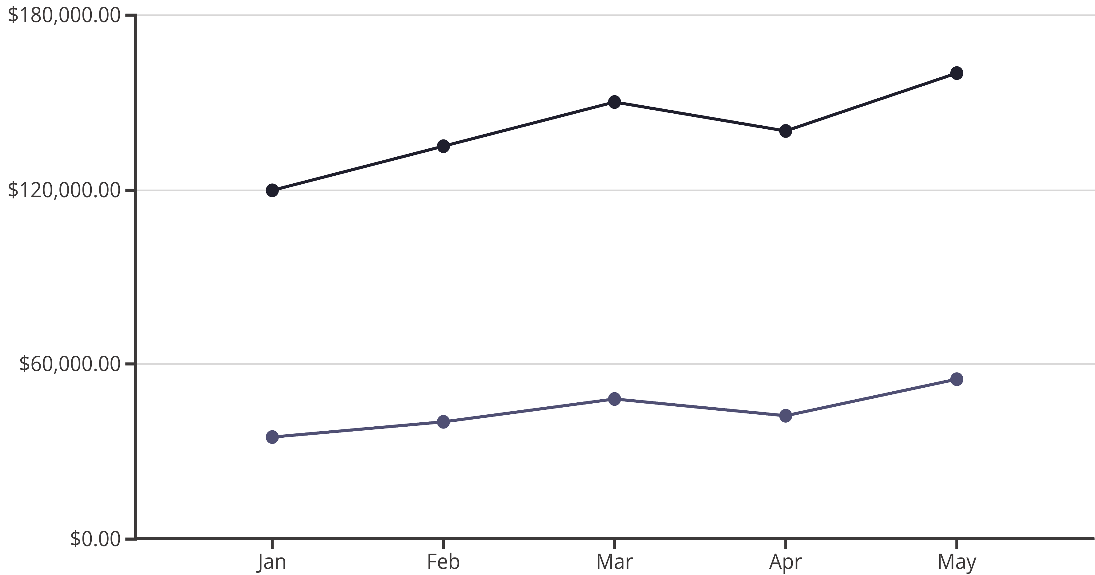
Time-Series Analysis
Revenue
Profit
Incorporate time-series charts to visualize trends and patterns over time. This helps identify seasonality, growth trajectories, and deviations, providing critical context for performance analysis.

Slide 6
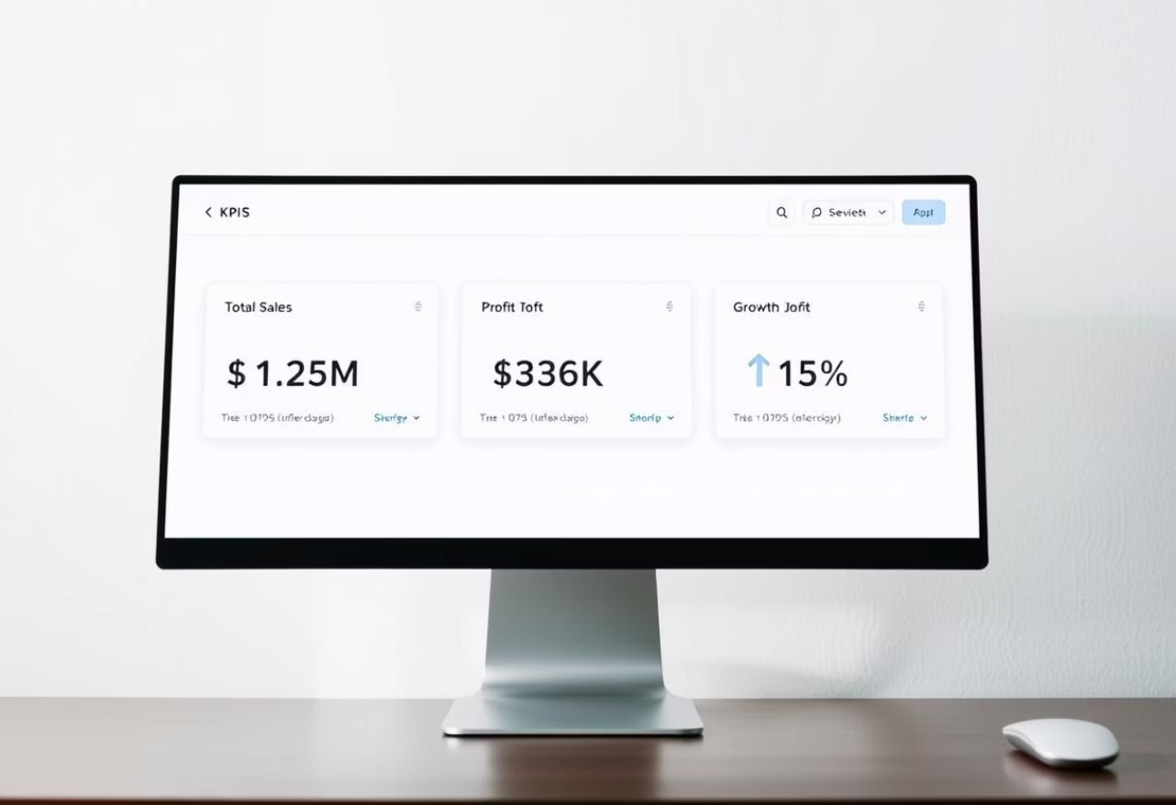
Summary Cards and Visual Consistency
Summary Cards
Highlight key totals (e.g., total sales, net profit).
Consistent Theme
Apply a cohesive color palette and font style.

Slide 7
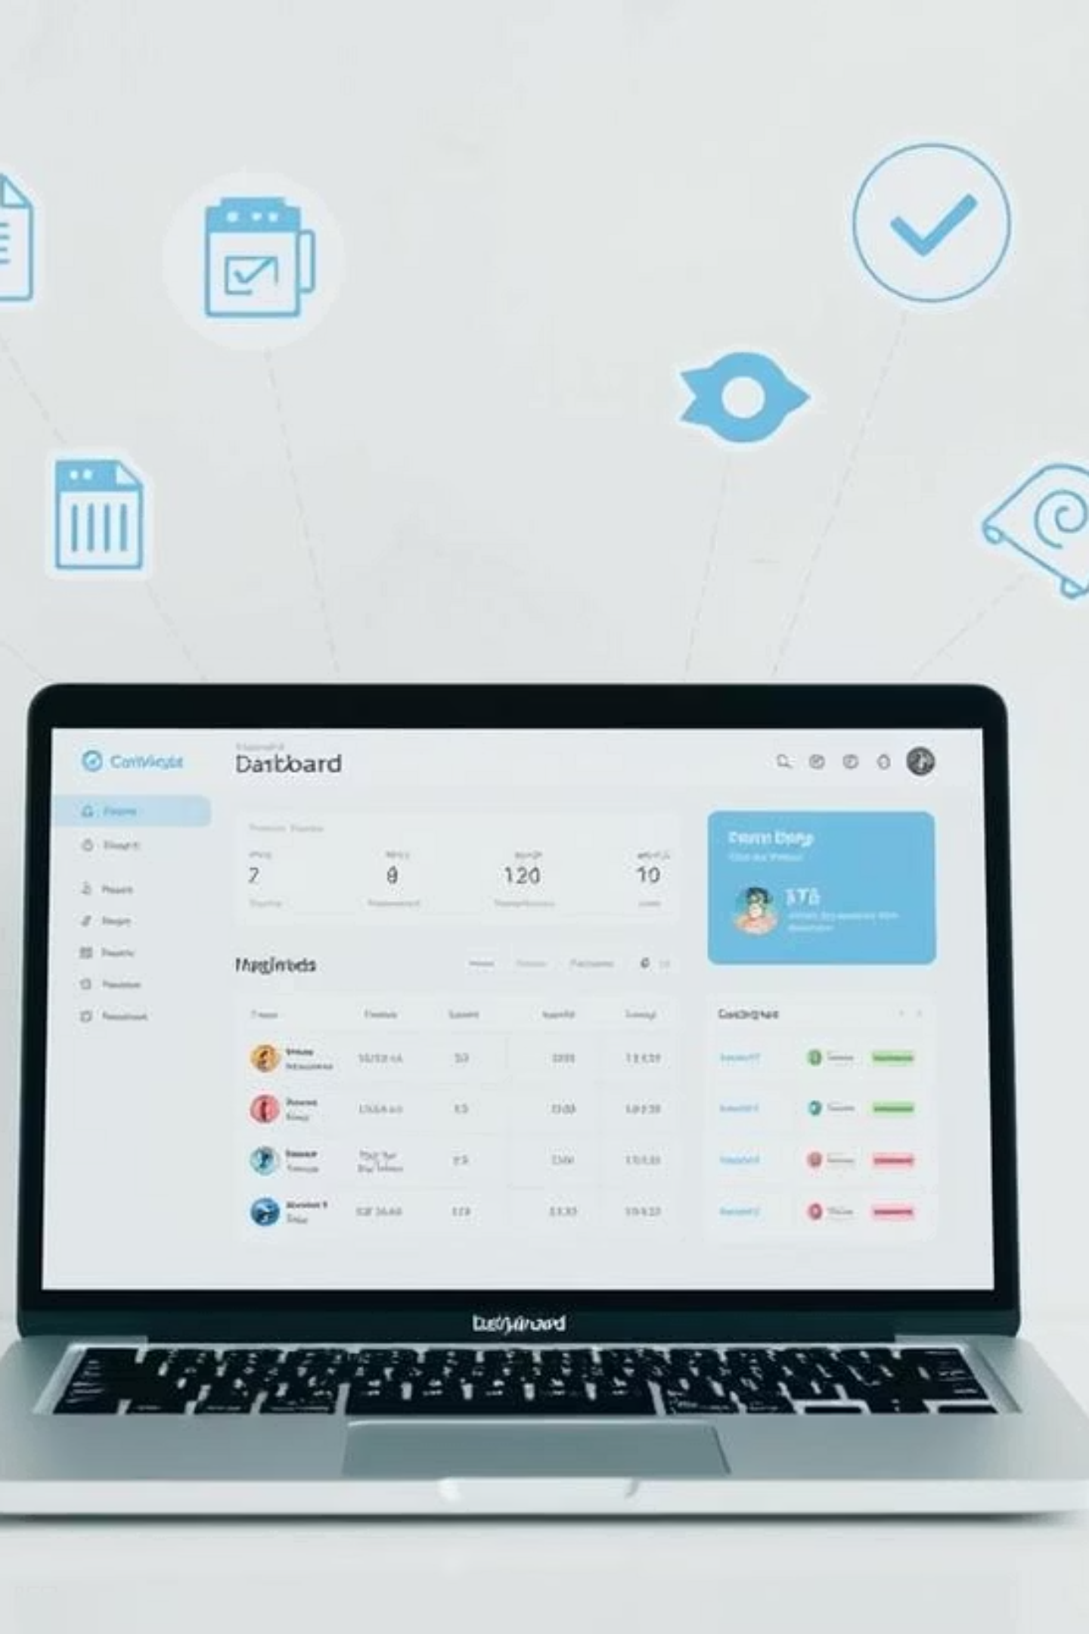




Tools and Deliverables
Power BI
Robust for data modeling and visualization.
Tableau
Intuitive for interactive and engaging dashboards.
Interactive Dashboard
The primary, dynamic deliverable.
PPT Summary
Key findings and actionable recommendations.

Slide 8

Key Takeaways and Next Steps
1
Focus on User Needs
Always design with the end-user (stakeholder) in mind, ensuring clarity and utility.
2
Iterate and Refine
Gather feedback and continuously improve the dashboard for optimal impact.
3
Drive Business Decisions
The ultimate goal is to empower informed decision-making and foster growth.

